Slide 1
Week 1 – Graphing Exercise

Slide 2
Terms
x-axis – horizontal axis at the bottom of the graph
independent variable – used to see if it has an effect on a second variable; represented on x-axis
y-axis – vertical axis on the left side of the graph
dependent variable – the variable that is being tested in an experiment; represented on y-axis

Slide 3
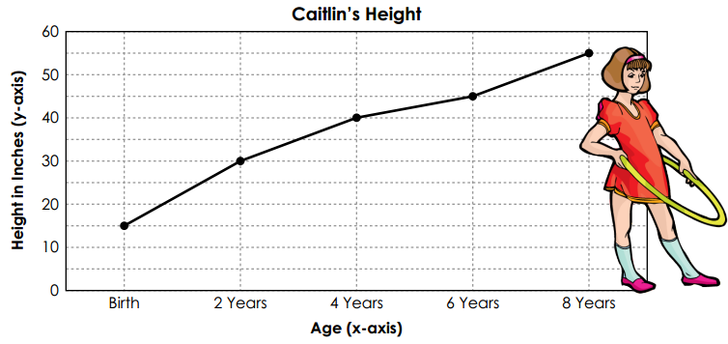

Slide 4
Proportionality
direct relationship – exists when two variables increase or decrease at the same rate; the graph has a linear shape
indirect relationship – exists when one variable increases as the other decreases; the graph has a hyperbolic shape

Slide 5
All graphs should have:
A title “dependent vs. independent variable”
Each axis should be labeled
Each axis should have an appropriate scale
Each axis should show units
A best-fit line or curve should be drawn to represent the data

Slide 6
Volume vs. Temperature
Temperature (K) | Volume (L)
40 | 20.0
80 | 40.0
120 | 60.0
160 | 80.0
200 | 100.0
240 | 120.0
280 | 140.0
320 | 160.0
360 | 180.0
400 | 200.0
440 | 220.0

Slide 7
Pressure vs. Volume
Volume (L) | Pressure (atm)
1.0 | 150.0
1.5 | 100.0
2.0 | 75.0
2.5 | 60.0
3.0 | 50.0
3.5 | 42.9
4.0 | 37.5
4.5 | 33.5
5.0 | 30.0
5.5 | 27.3
6.0 | 25.0

